Slide 1
Topological Data Analysis MVA 2021
“ Topological Autoencoders ” [Moor et al. ICML 2020]
Presented By:
Saifeddine Barkia - Siwar Mhadhbi - Eya Ghamgui

Slide 2
Plan
Introduction
Background
Proposed approach
Experiments and results
Conclusion

Slide 3
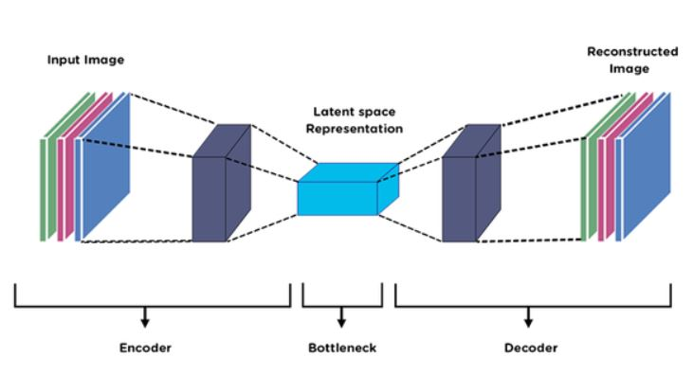
Introduction
+
Persistent homology

Slide 4
Background
Simplicial homology :
the sequence of homology groups of a simplicial complex. It formalizes the idea of the number of holes of a given dimension in the complex.
Why not simplicial homology?
→ The underlying manifold M is unknown
→ Unstable procedure due to the discrete nature of X
Persistent homology
It extends simplicial homology
It tracks changes in the homology groups

Slide 5
2.Proposed Approach

Slide 6
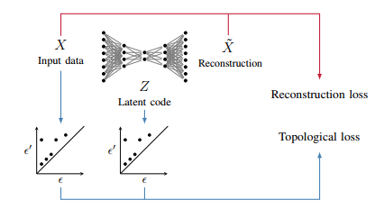
Overview of the method

Slide 7






2.1 Vietoris–Rips Complex
Construction of the Vietoris–Rips Complex
For a given scale
denotes al the simplicies of X whose elements
satisfying
: matrix of pairwise distances of the point cloud X
⇔
We are working on a finite number of points : no need to explore all the scales

Slide 8





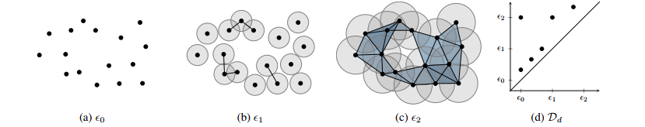
We denote by the persistent homology of the Vietoris-Rips complex
=
where :
: d-dimensional Persistence diagram containing coordinate of the form (a,b)
: d-dimensional Persistence pairing containing indices (i,j) corresponding to simplicies

Slide 9
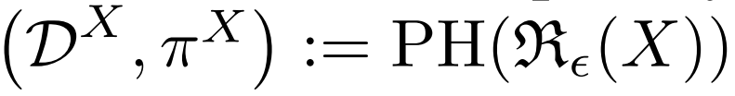
Selecting indices from from pairings
Select indices in the persistence pairing and map them back to a distance between two vertices.
For 0-dimensional features, each index corresponds to an edge in the minimum spanning tree of the data-set
Only 0-dimensional features:
No huge improvements for 1-dimensional features
Complexity reason
For the rest of the presentation we denote by
the 0-dimensional
persistent homology

Slide 10
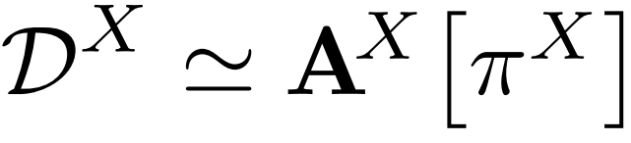

Topological Autoencoder
Autoencoder : h o g
Decoder : Z -> X
Encoder : X -> Z
Goal: Learn a latent encoding that best preserves the data space topology in latent space.
X : point cloud mini-batch from the data space.
Forward pass of the autoencoder : ;

Slide 11
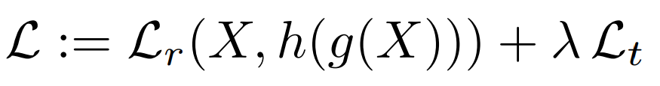
Topological Autoencoder
Combined Loss
Reconstruction Loss
Topological Loss
Regularization term

Slide 12
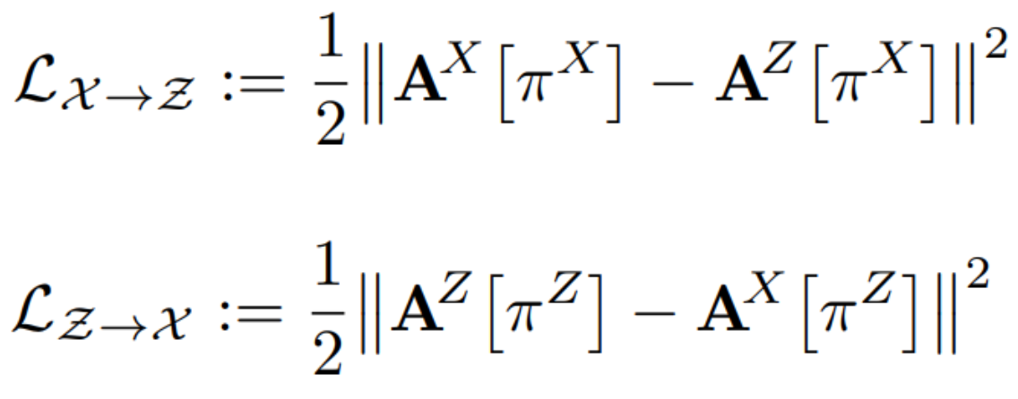

Topological Autoencoder
Combined Loss
Reconstruction Loss
Topological Loss
Regularization term
Topological Loss
Key idea: align and preserve topologically relevant distances from both spaces.

Slide 13

Topological Autoencoder
Differentiability
Persistence pairing does not change upon a small perturbation.
Topological loss differentiable for each update step during training.
Employ topology directly as a constraint for modern deep learning methods. \o/
Stability
Stability of persistence diagrams with respect to small perturbations of the underlying space.
Stability on the level of mini-batches. Suitable approximations of the persistent homology of a data set.

Slide 14
3. Experiments

Slide 15
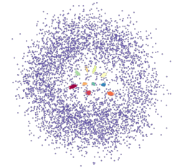
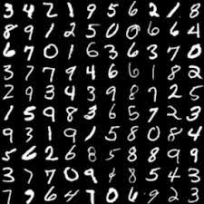

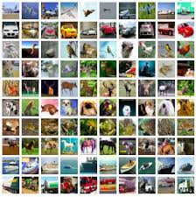
Experimental setup
Setup
Datasets
Synthetic dataset | SPHERES
Real-world datasets | MNIST
 | FASHION-MNIST
 | CIFAR-10
(a)
(b)
(c)
(d)
Figure 1: (a) SPHERES (b) MNIST (c) FASHION-MNIST (d) CIFAR-10.

Slide 16

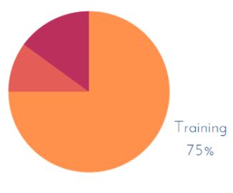

Experimental setup
Setup
Baselines
Training procedure
Comparison with dimensionality reduction
techniques :
UMAP (McInnes et al., 2018)
t-SNE (van der Maaten & Hinton, 2008)
Isomap (Tenenbaum et al., 2000)
PCA
Autoencoders (AE)
Architectures:
For synthetic data set:
Simple MLP (multilayer perceptron)
For real world data sets
Architecture inspired by DeepAE (Hinton & Salakhutdinov, 2006).

Slide 17


Evaluation Metrics
Reconstruction error: Data Mean Squared Error (MSE)
Dimensionality reduction
quality metrics
: mean squared error
: mean relative rank error
: trustworthiness measure
: continuity measure
Kullback-Leibler divergence :

Slide 18
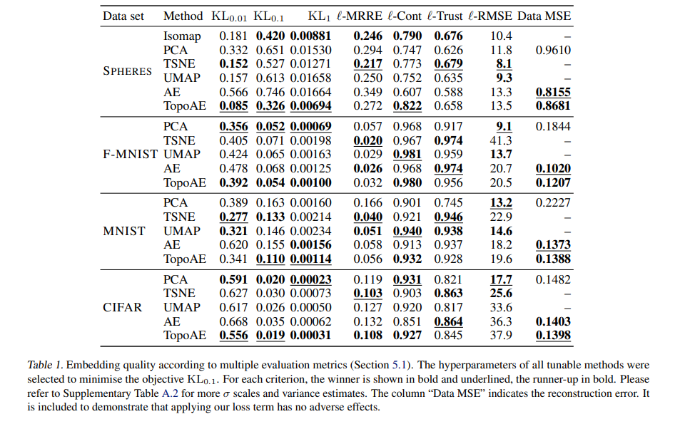
Quantitative Results [1]

Slide 19
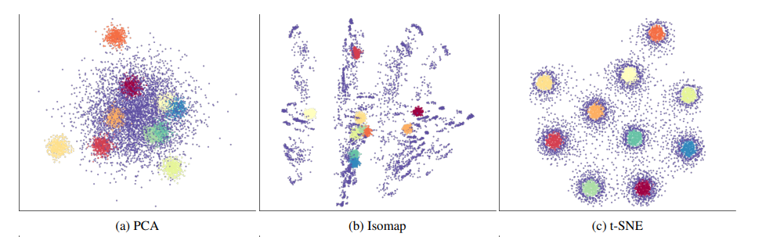
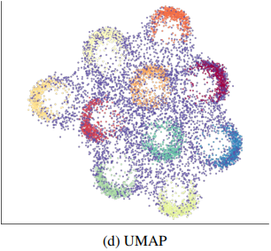
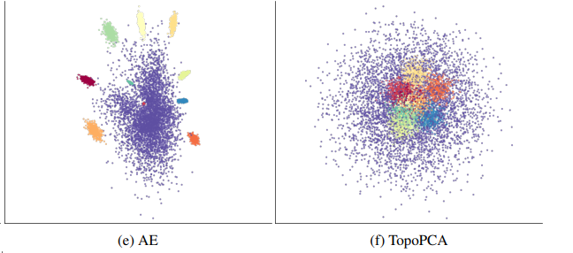
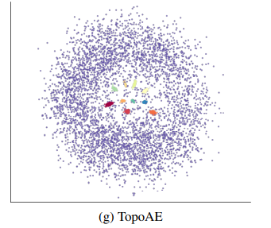
Qualitative Results [1]
SPHERES data set

Slide 20
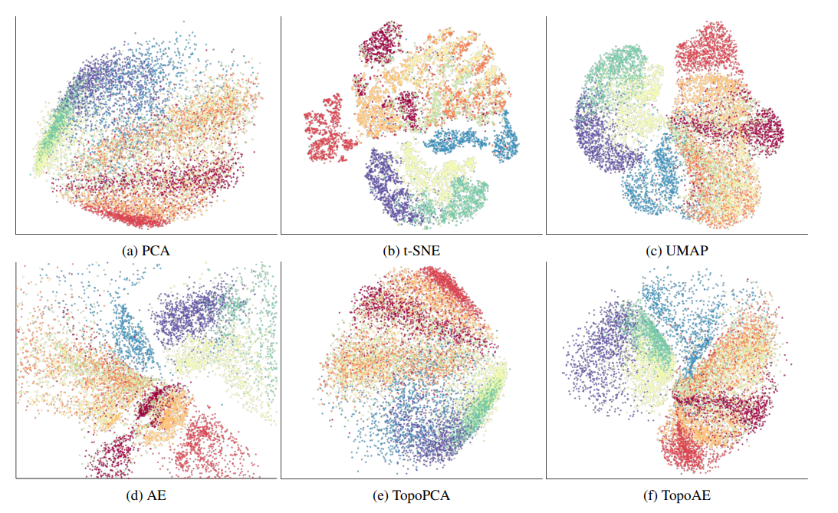
Qualitative Results [1]
FASHION-MNIST data set

Slide 21
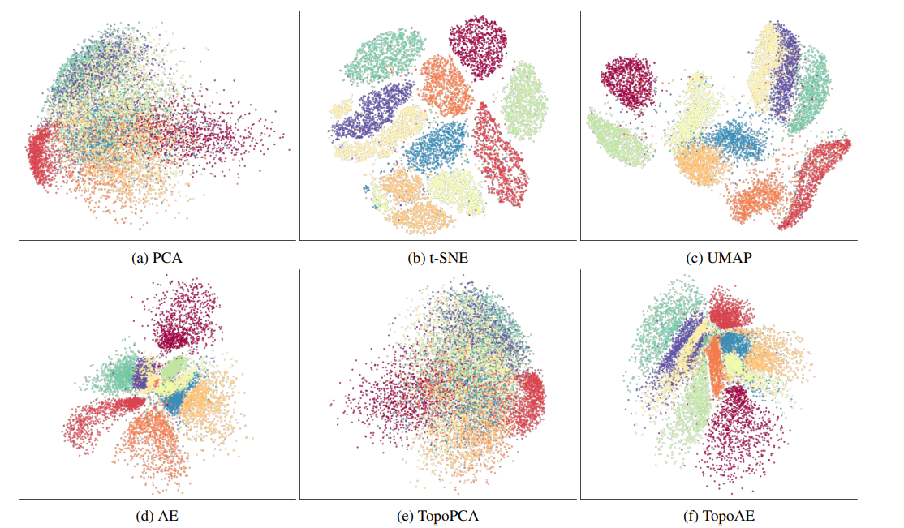
Qualitative Results [1]
MNIST data set

Slide 22
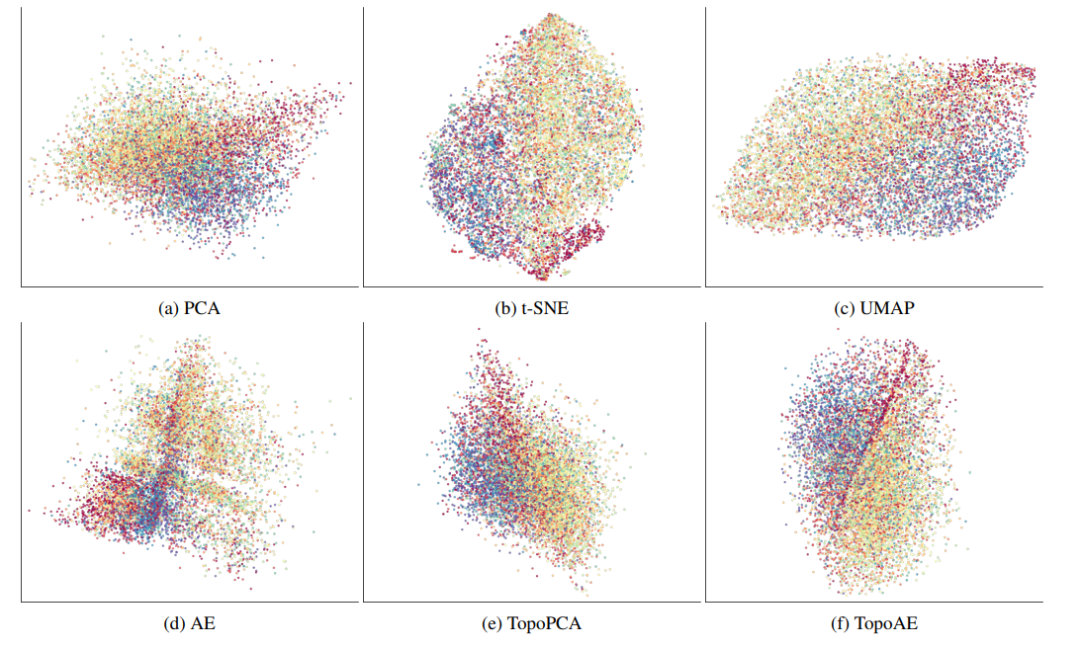
Qualitative Results [1]
CIFAR-10 data set

Slide 23
Advantages
This approach:
Provides interesting and interpretable representations and organize the classes in a meaningful way.
Able to obtain the values of the gradients that will be used in the update step in the training.
Shows that persistent homology computations can be combined with backpropagation.

Slide 24
Conclusion & Future Work
Topological Autoencoders is a new method that preserves the topological information.
Topological loss is highly generalizable.
Topological loss is not limited to standard autoencoders.
This approach can be applied to variational configurations or create a topology-aware variant of PCA.
Addressing classification scenarios with topology-preserving loss terms.

Slide 25
Thank you for your attention !

Slide 26
References
[1] https://arxiv.org/pdf/1906.00722.pdf

Slide 27
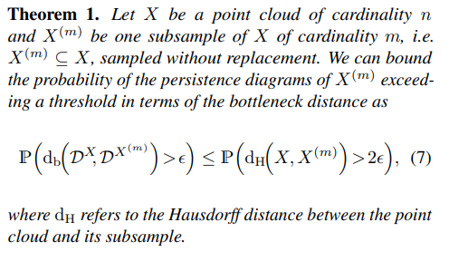
Appendix

Slide 28
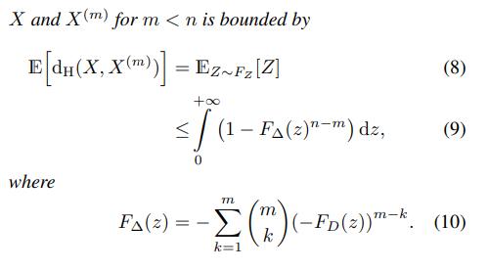
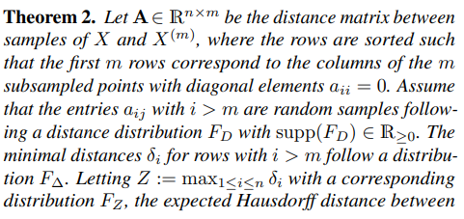
Appendix

